Slide 1
Day 2: Advanced Topics in GIS

Slide 2
Some housekeeping
On Thursday (April 25), we will be meeting at Four Points by Sheraton Hotel
This Friday is a holiday (though the Bank office is open)!
Afternoon session (optional)
Please start thinking about your research ideas for group study presentation

Slide 3
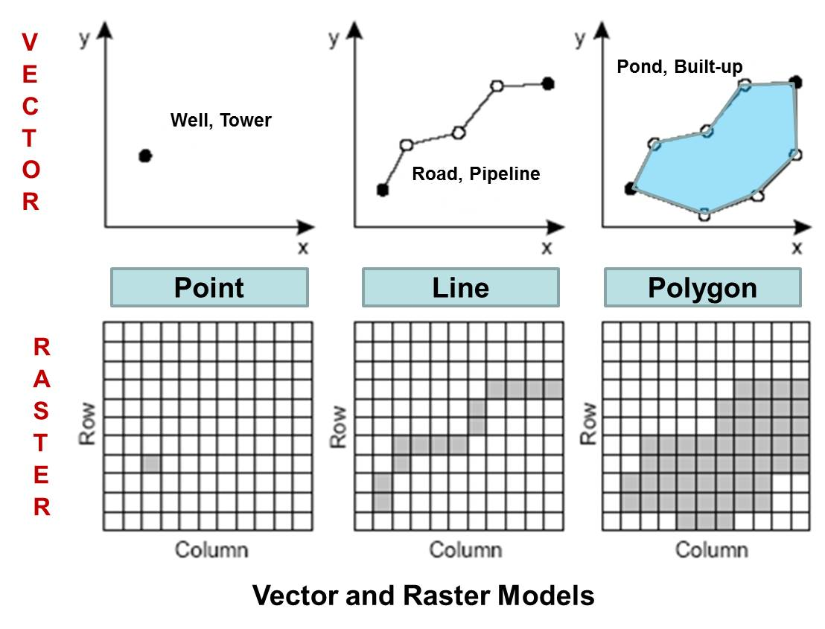
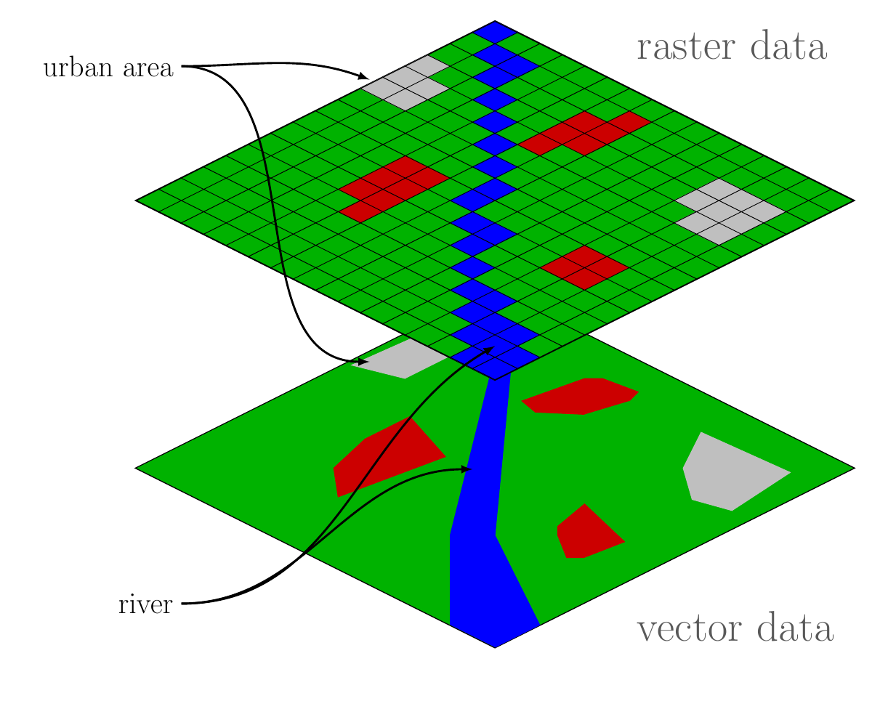
Recap of what’s covered on Day 1

Slide 4
Today’s Agenda
Reprojection (revisited)
Zonal statistics
Data quality issues
Data cleaning
Geometric operations with vector data
Geometric operations with raster data
Hands-on exercise:
Combining raster and vector data
Data visualization

Slide 5
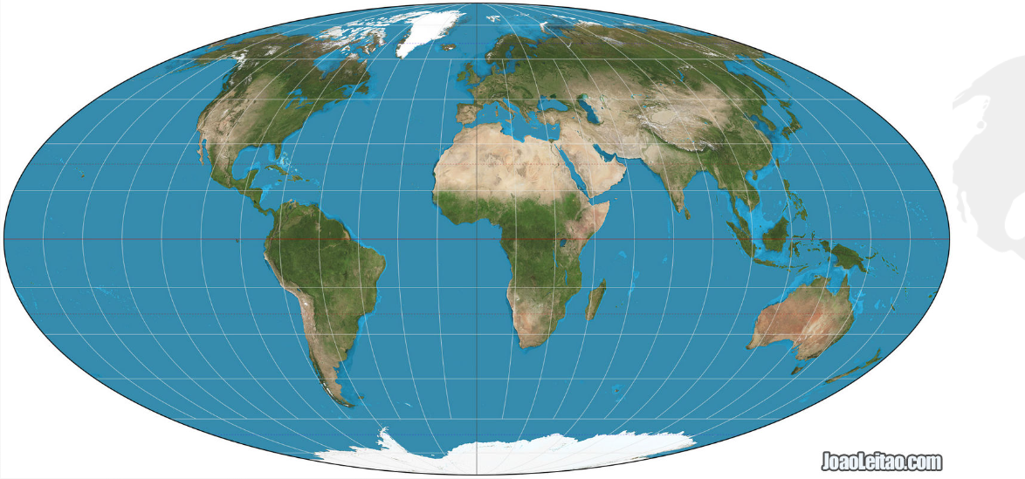
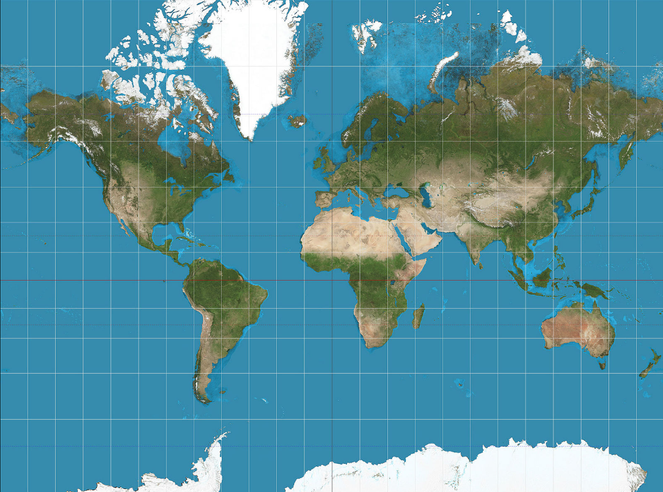
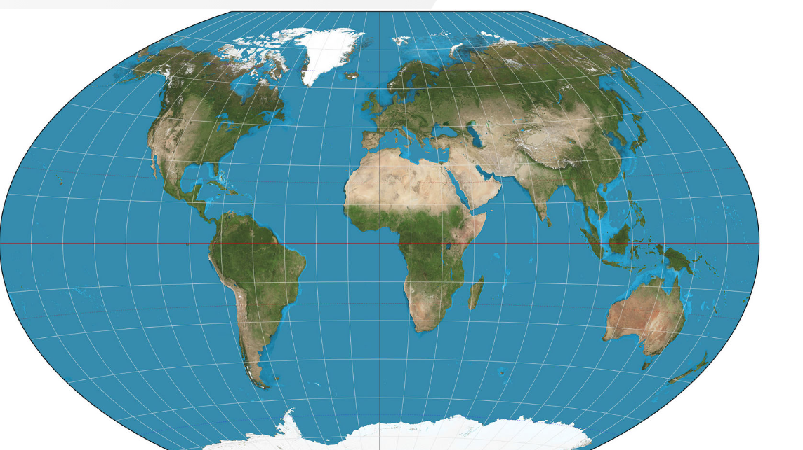
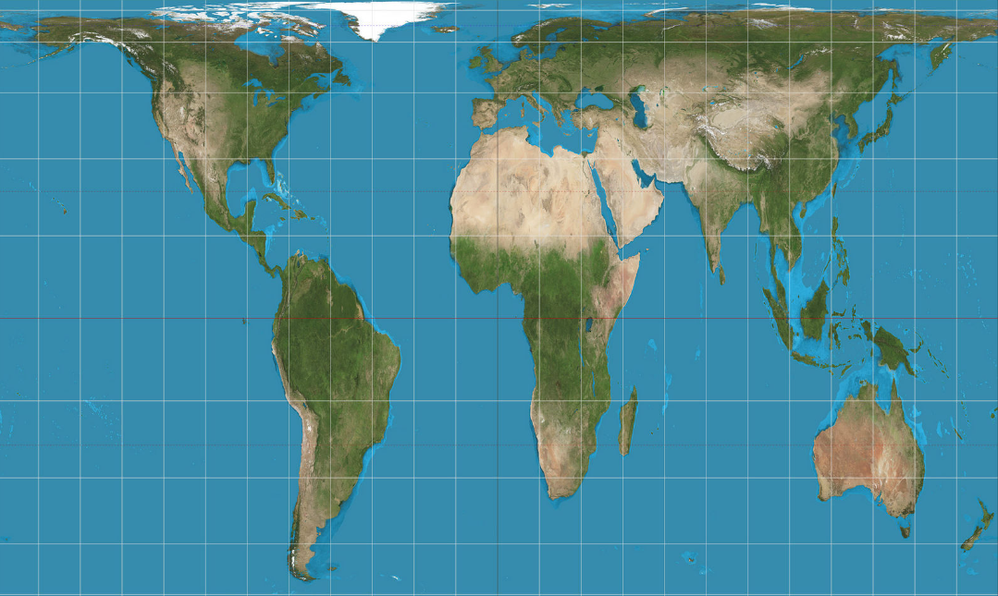
Reprojection revisited
The Mollweide Projection
(e.g., area analysis)
The Mercator Projection (e.g., navigation)
The Peters Projection
(e.g., preserving relative landmass)
The Winkel Tripel Projection (e.g., relatively low distortion across area, angle, and distance)

Slide 6
Reprojection revisited
It’s important to know the Coordinate Reference System (CRS) of spatial data whether it’s vector or raster data!
CRS provide a standardized way of describing locations, chosen depending on when the data was collected, the geographic extent of the data, the purpose of the data, etc.
WGS84 (EPSG:4326) is commonly used by organizations that provide GIS data for the entire globe or many countries (CRS used by Google Earth)
But some datasets do not use WGS84, like data from Global Human Settlement Layer

Slide 7
Reprojection revisited
Use EPSG codes to standardize projections within a project:
A particular CRS can be referenced by its EPSG code (i.e., epsg:4121).
The EPSG is a catalogue of CRS and Coordinate Transformations.
You can look up an appropriate EPSG code for your own country in https://epsg.io/.
For instance, when computing areas in km^2, you would need to reproject your data to UTM using EPSG code that’s appropriate for your analytical purpose.

Slide 8
Why does differences in CRS matter?
2-lecture_code.R

Slide 9
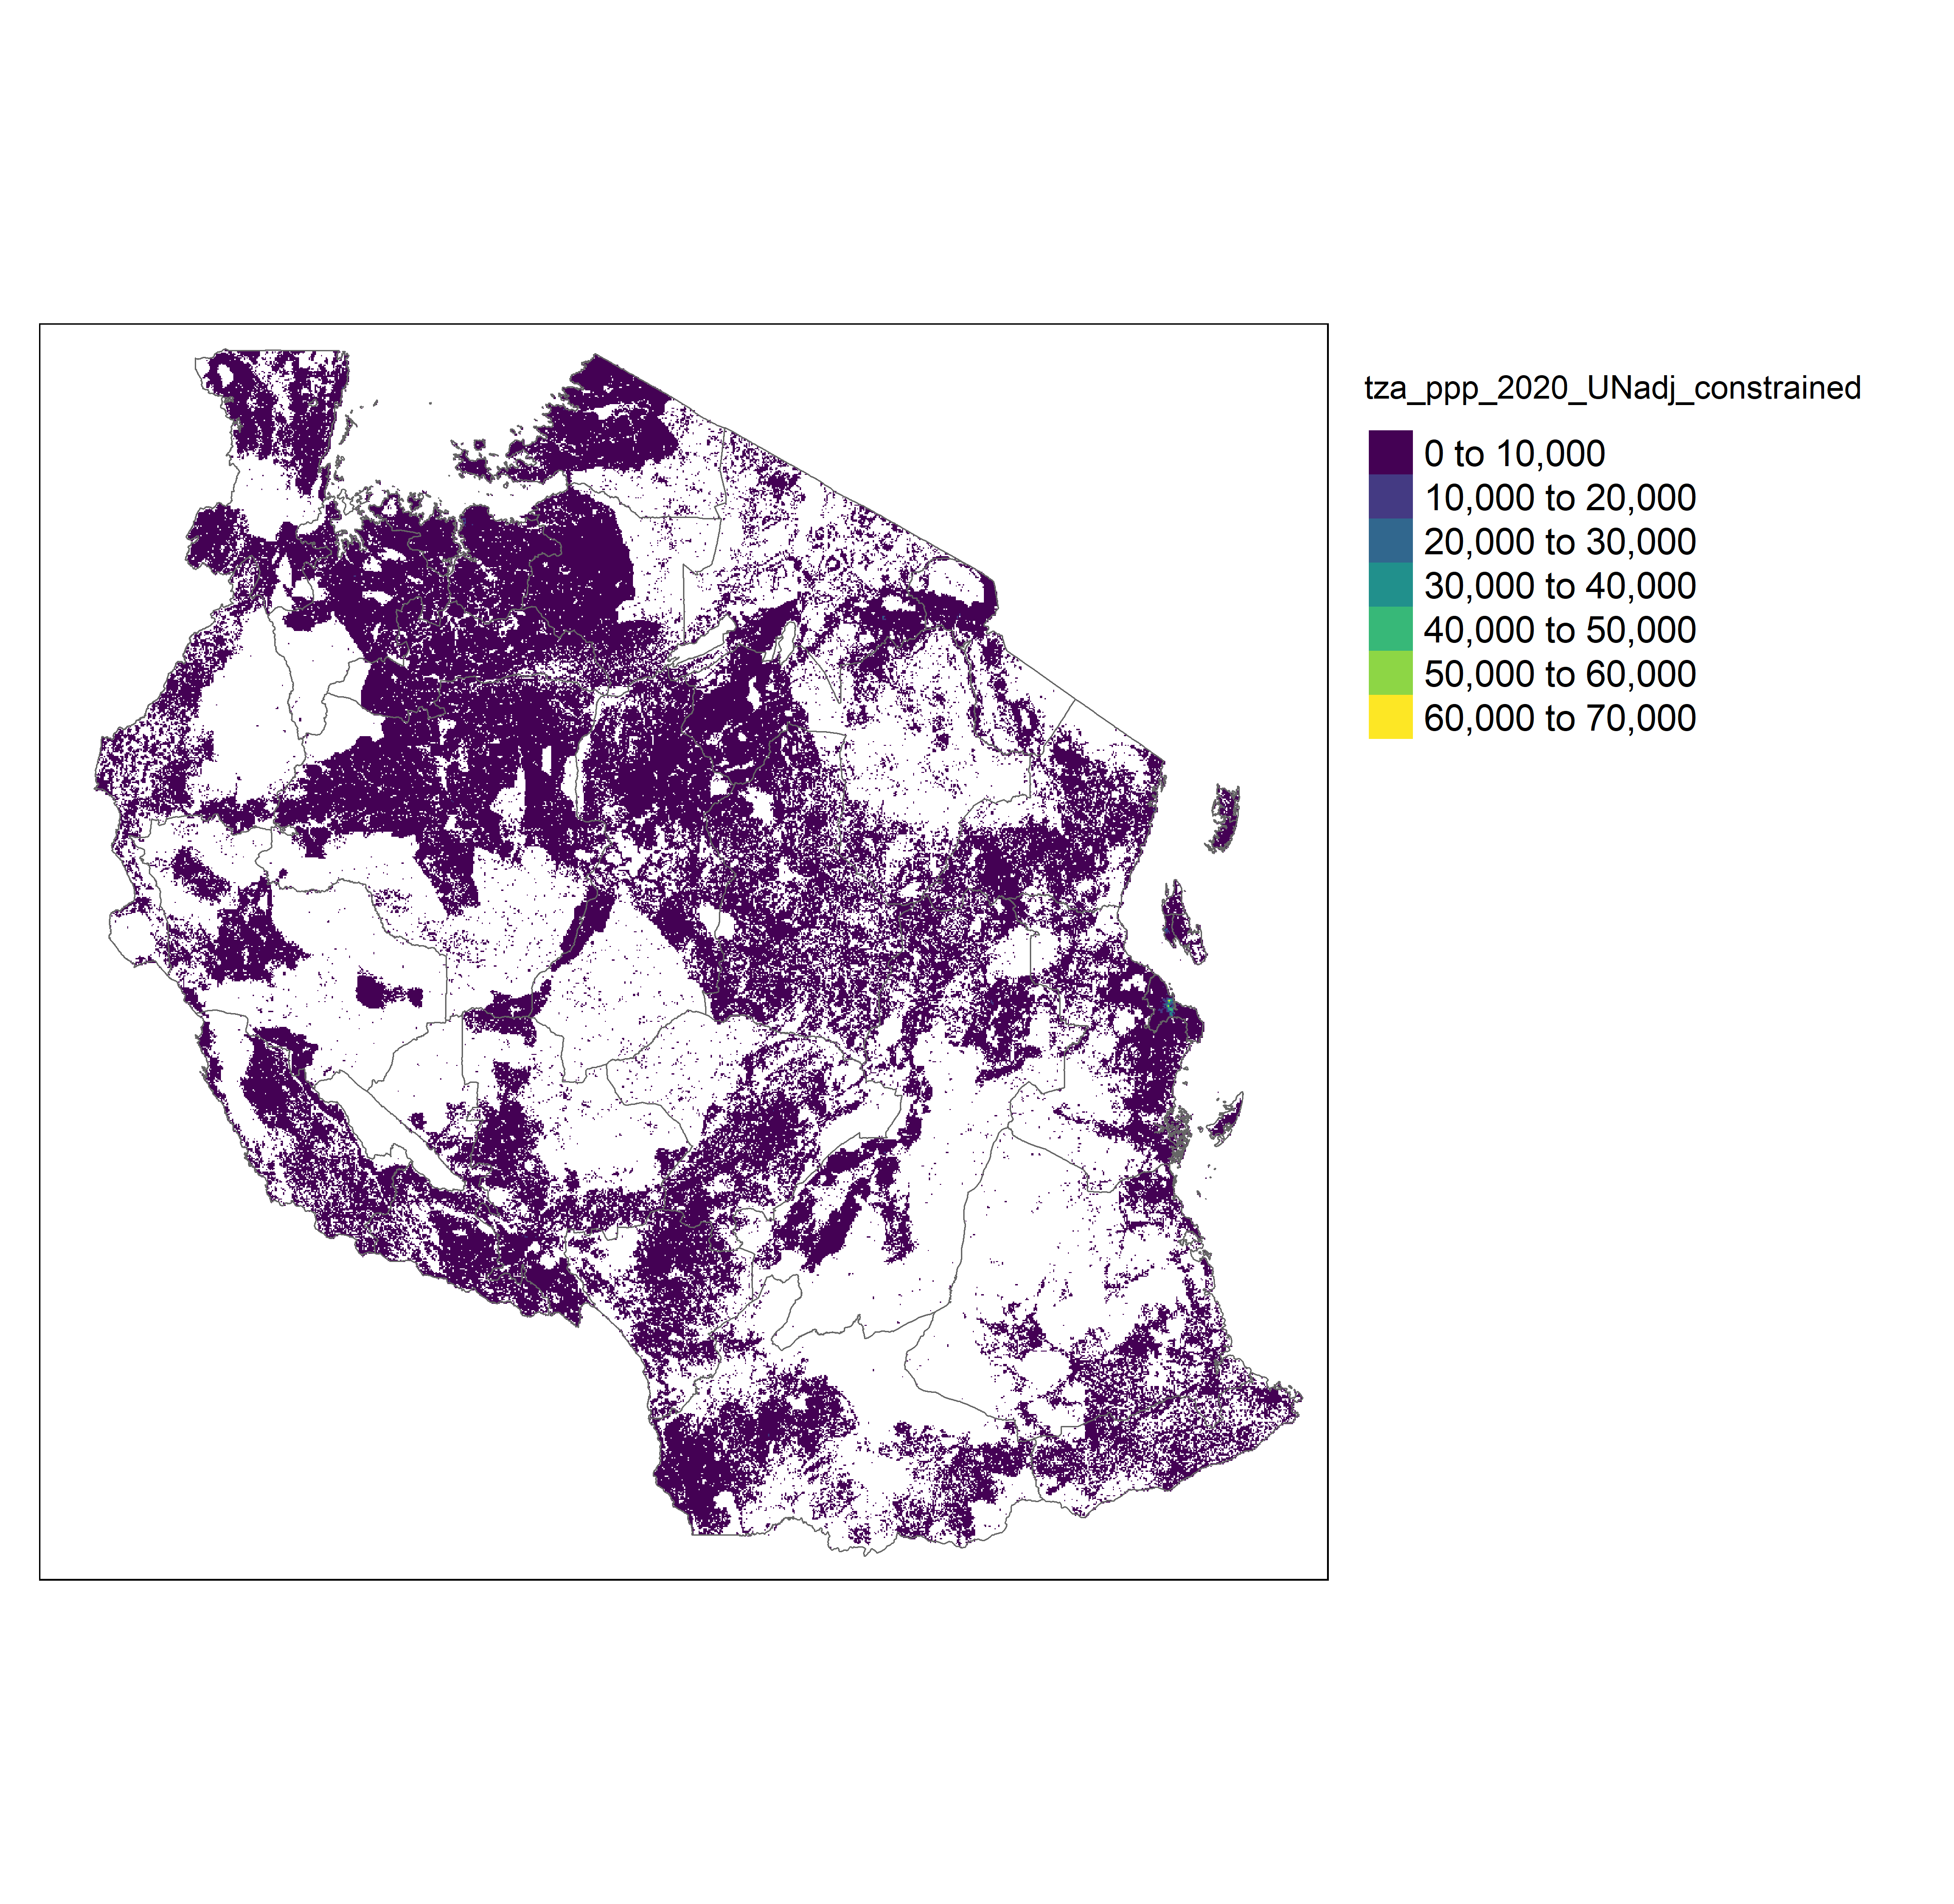
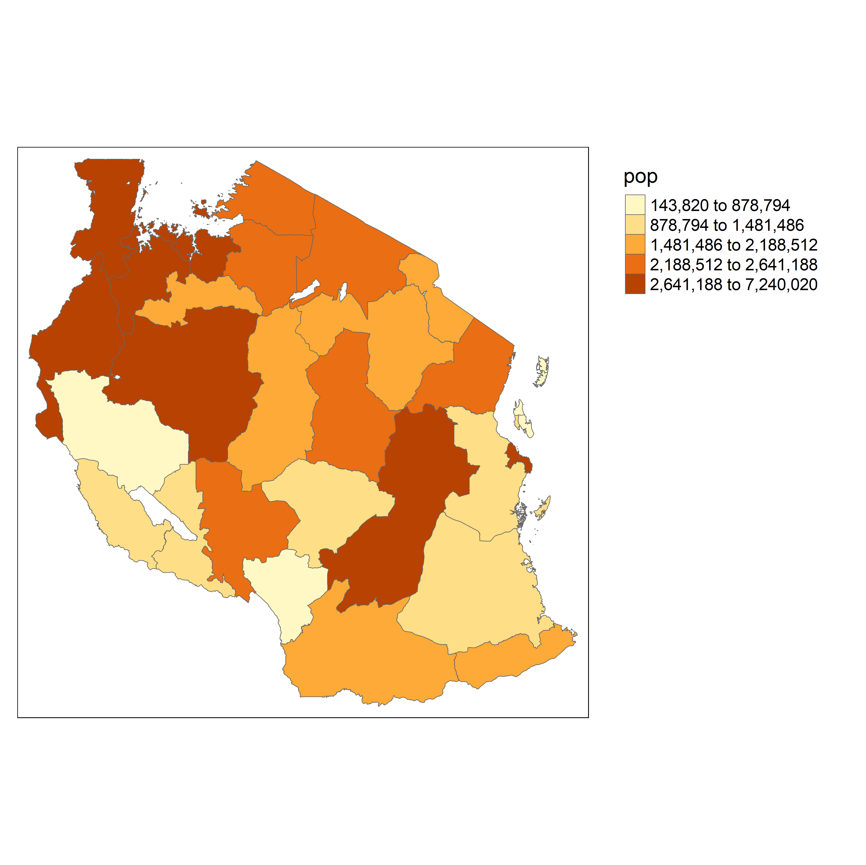
Zonal Statistics
Zonal statistics is a term for raster values that are summarized over polygonal areas.
Example:

Slide 10
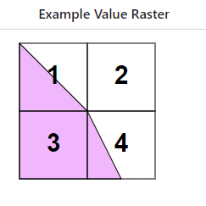
Zonal Statistics: How do we do this in R (link)
exactextractr is an R package that quickly and accurately summarizes raster values over polygonal areas, commonly referred to as zonal statistics.
Unlike most zonal statistics implementations, it handles grid cells that are partially covered by a polygon.
Despite this, it performs faster than other packages for many real-world applications.
If using “sum” in exact_extract()
50%
0%
0.5*1 + 0*2 + 1*3 + 0.25 * 4 = 4.5
If using “sum” in exact_extract()
100%
25%
(0.5*1 + 0*2 + 1*3 + 0.25 * 4) /
(0.5 + 1 + 0.25) = 2.57

Slide 11
Zonal Statistics: How do we do this in R
2-lecture_code.R

Slide 12
Data quality

Slide 13
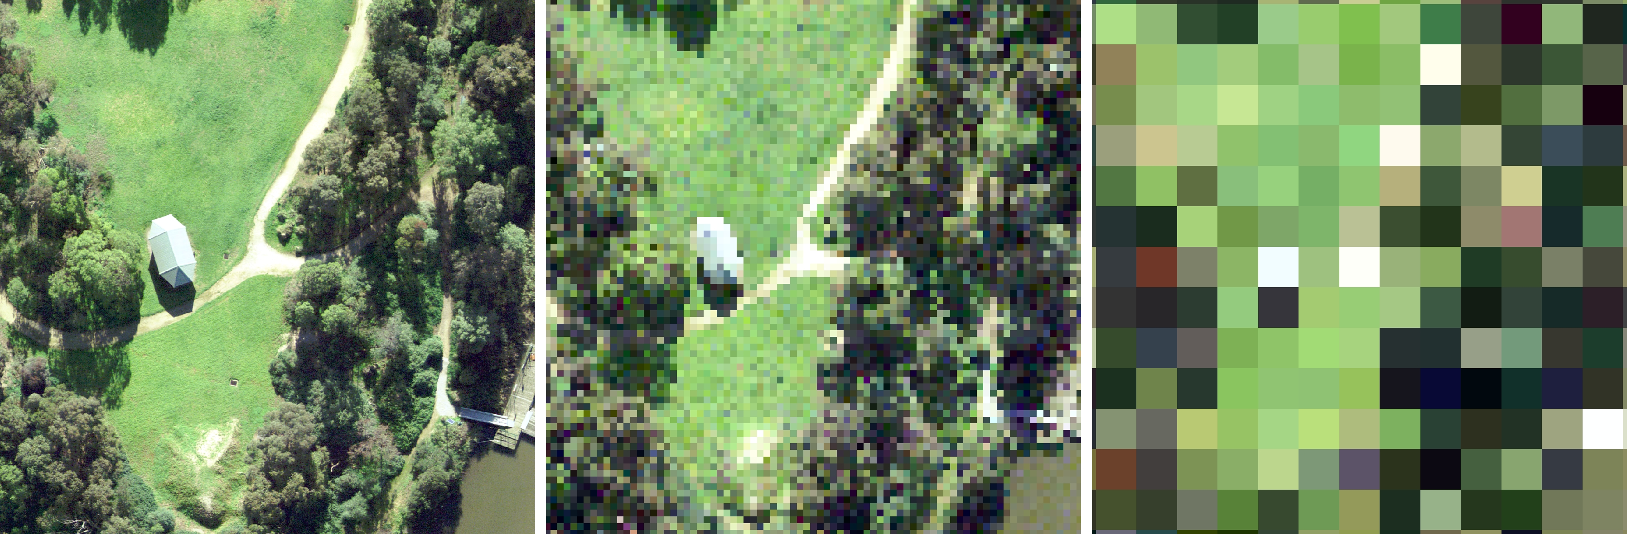
Data quality
Precision in raster data
Higher resolution + precision
Lower resolution + precision

Slide 14
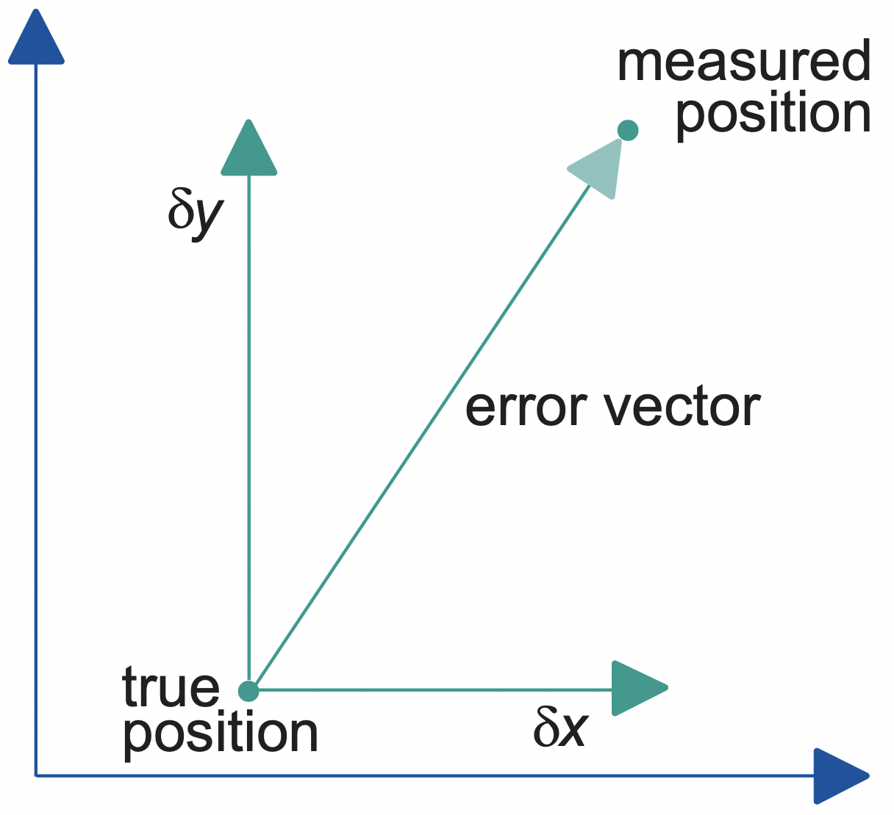
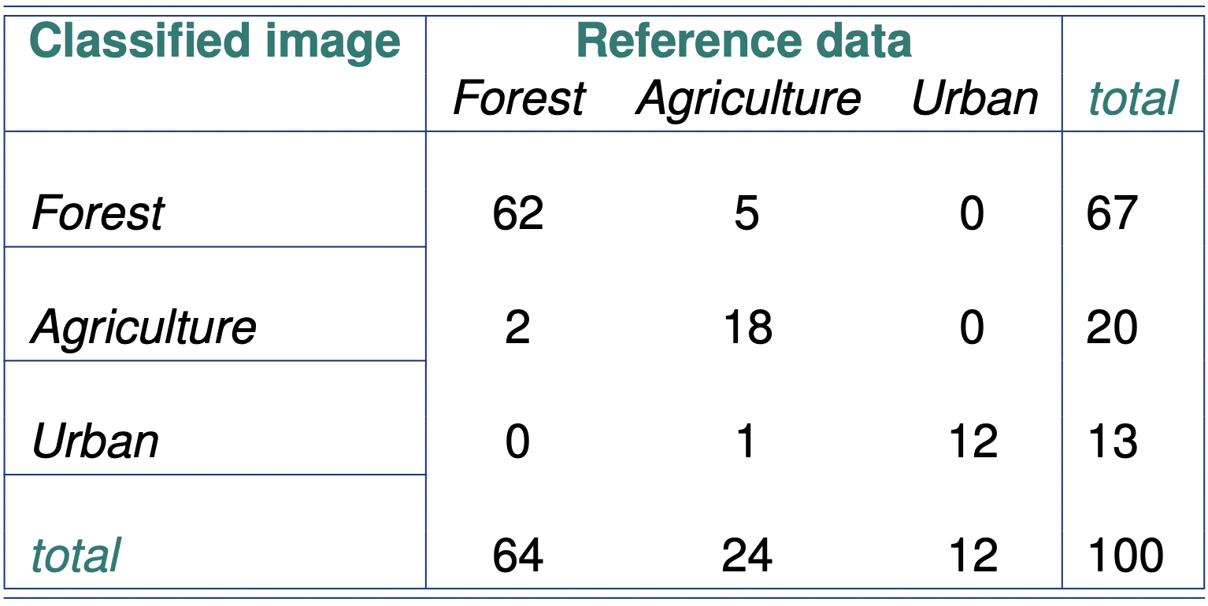
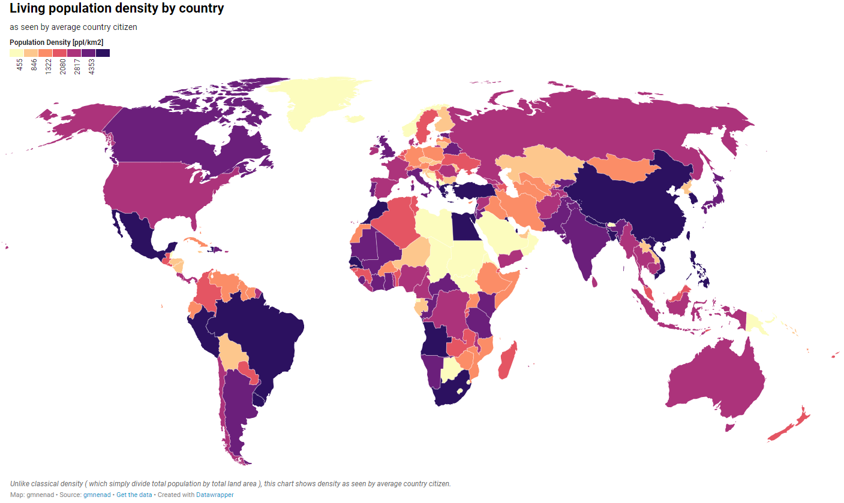



Data quality
Positional accuracy
Example: location of schools
Attribute accuracy
Example: type of land cover
Temporal accuracy
Example: year of population statistics
Year: 2020 Year: 2015
Lineage
Example: metadata of how the population data is collected
Completeness
Example: availability of economic data in all regions
Logical consistency
Example: Consistency among population, area, and population density

Slide 15
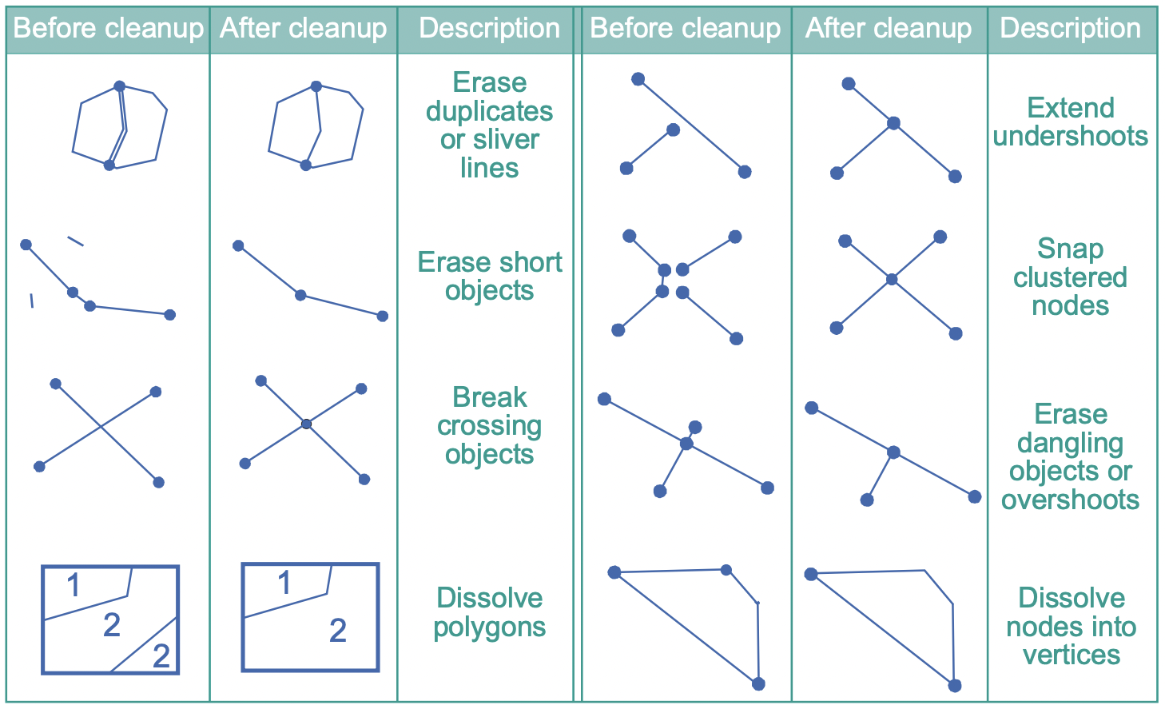
Data quality
Spatial data clean-up procedure

Slide 16
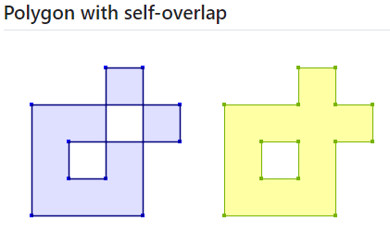
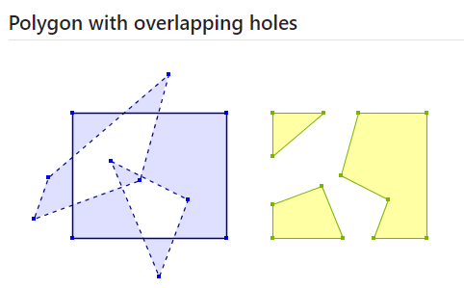
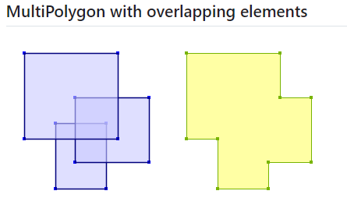
How to fix invalid geometry: st_make_valid()

Slide 17
How to correct geometry issues
2-lecture_code.R

Slide 18
Geometric operations with vector data

Slide 19
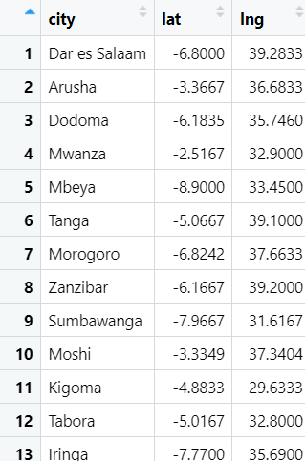
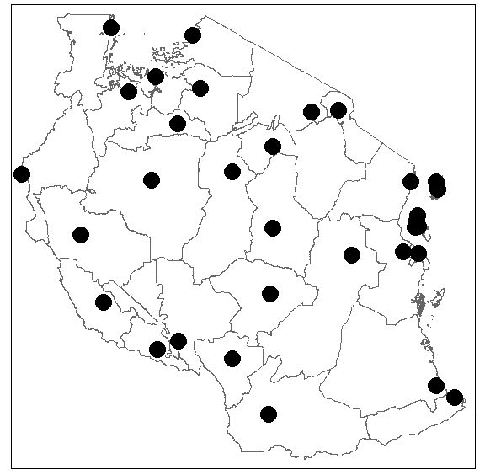
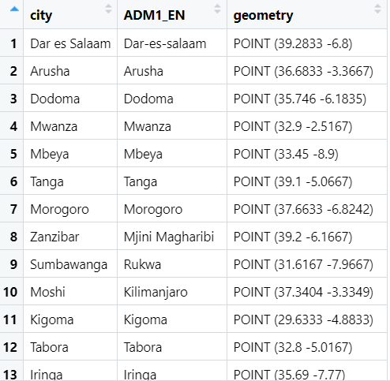
Key functions in sf package
st_join(x,y): spatially joint y’s attributes to x
Notes:
See the following link for more details: https://geobgu.xyz/r/the-r-environment.html.

Slide 20
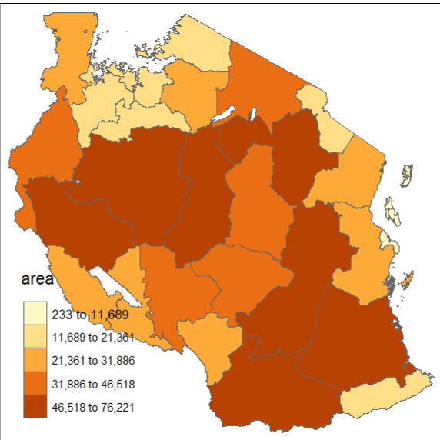
Key functions in sf package
st_area(x): calculate area of x
Notes:
See the following link for more details: https://geobgu.xyz/r/the-r-environment.html.

Slide 21
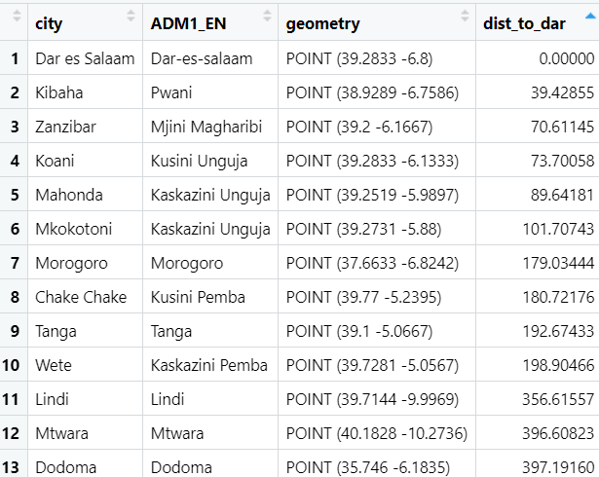
Key functions in sf package
st_distance(x, y): calculate distance between pairs of objects x and y
Notes:
See the following link for more details: https://geobgu.xyz/r/the-r-environment.html.

Slide 22
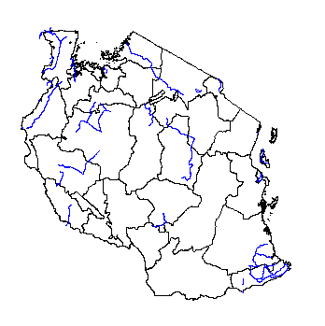
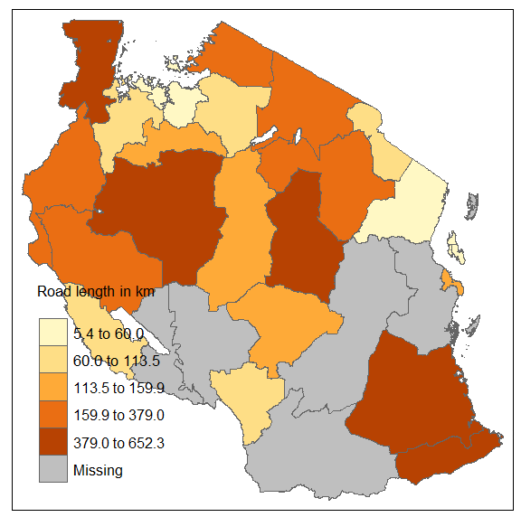
Key functions in sf package
st_length(x): calculate the length of x
Notes:
See the following link for more details: https://geobgu.xyz/r/the-r-environment.html.

Slide 23
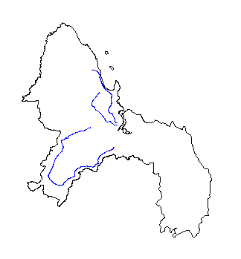
Key functions in sf package
st_intersections(x, y): returns a geometry for the intersection of two geometries x and y
Notes:
See the following link for more details: https://geobgu.xyz/r/the-r-environment.html.

Slide 24
Geometric operations with vector data
2-lecture_code.R

Slide 25
Geometric operations with raster data

Slide 26
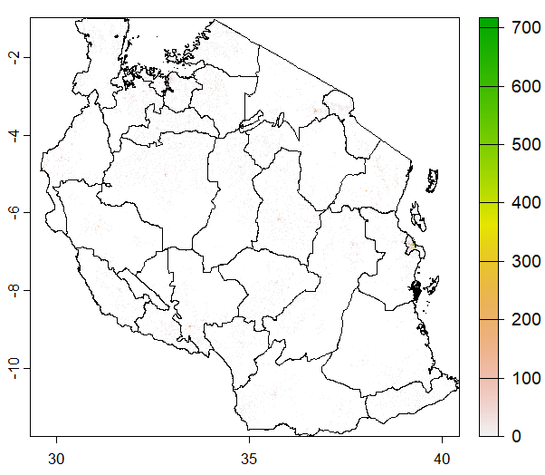
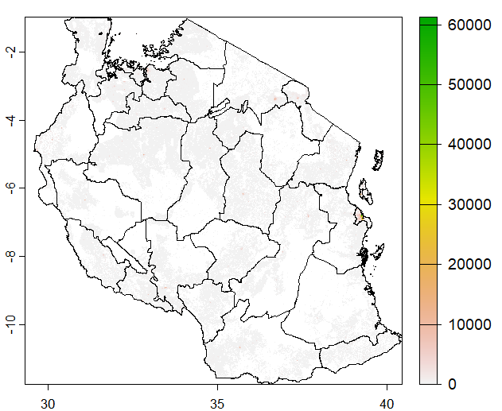
Key functions in terra package
aggregate(x, fact = n, fun = FUN): aggregate x by the factor of n by calculating FUN
aggregate(pop, fact=10, fun=“sum”)
Notes:
See the following link for more details: https://geobgu.xyz/r/the-r-environment.html.

Slide 27
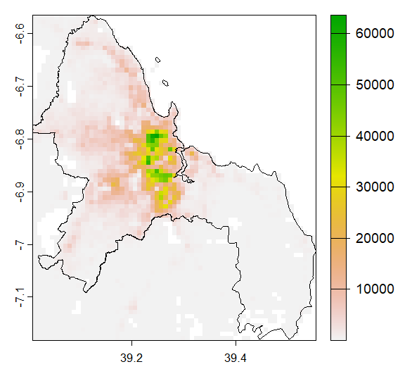
Key functions in terra package
crop(x, y): crops an sf object x to an extent of y
crop(pop_10, dar)
Notes:
See the following link for more details: https://geobgu.xyz/r/the-r-environment.html.

Slide 28
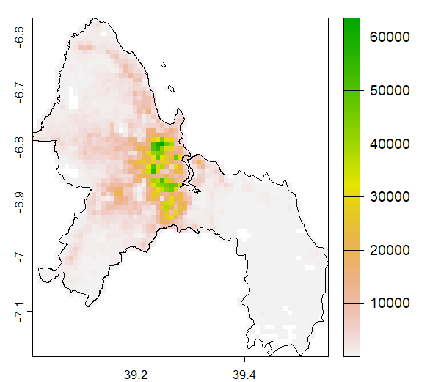
Key functions in terra package
mask(x, y): masks x by the boundary of y
mask(pop, dar)
Notes:
See the following link for more details: https://geobgu.xyz/r/the-r-environment.html.

Slide 29
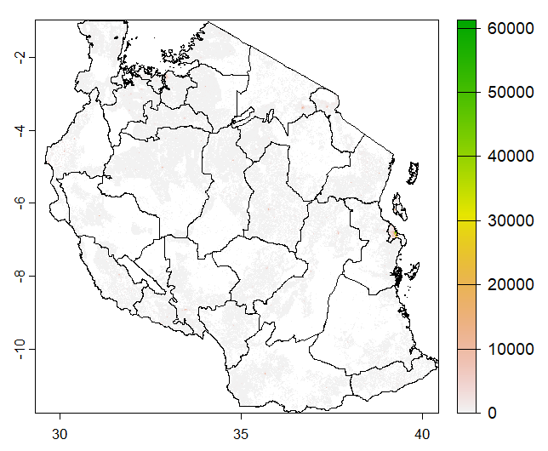
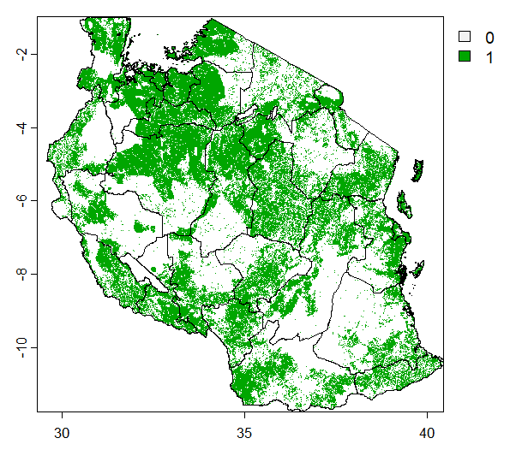
Key functions in terra package
app(x, fun, ...): apply fun to x
terra::app(pop, fun=function(x) ifelse(x>=5000, 0, 1))
Notes:
See the following link for more details: https://geobgu.xyz/r/the-r-environment.html.

Slide 30
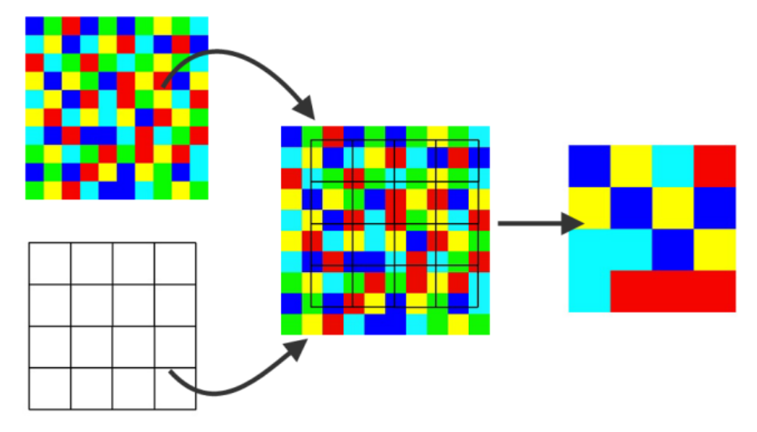
Key functions in terra package
resample(x,y): transfers values between SpatRaster objects that do not align (have a different origin and/or resolution)
Notes:
See the following link for more details: https://geobgu.xyz/r/the-r-environment.html.

Slide 31
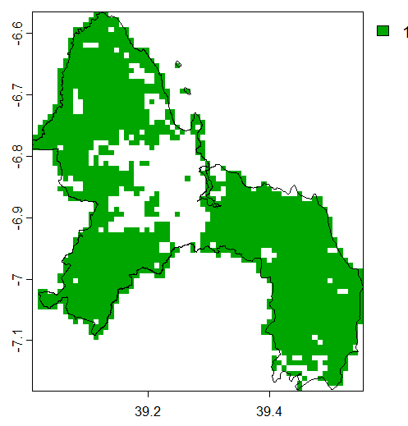
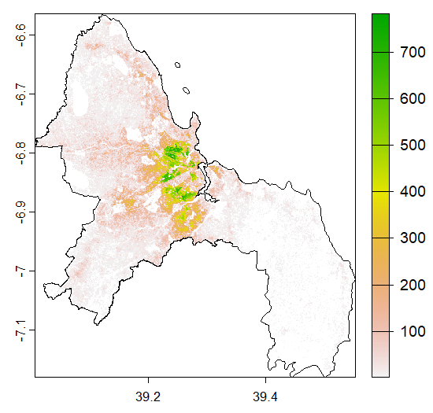
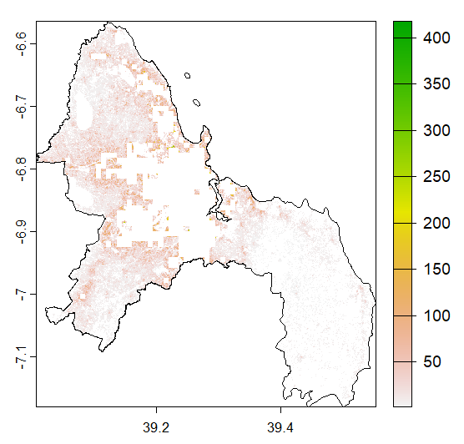
Key functions in terra package
resample(x,y): transfers values between SpatRaster objects that do not align (have a different origin and/or resolution)
1 if rural
Population
Population in rural
Notes:
See the following link for more details: https://geobgu.xyz/r/the-r-environment.html.

Slide 32
Geometric operations with raster data
2-lecture_code.R

Slide 33
Let’s do a hands-on exercise to recap what’s covered today!

Slide 34
2-handson.R
Hands-on exercise

